Slide 1
Supervising the Supervisors …
“PITCHING Responsible Science Matters”
Professor Robert Faff
Bond University & University of Qld

Slide 2
Three Goals … to help supervisors
Responsible Science … in a nutshell
Pitching Research framework … in a nutshell
Other Helpful Resources & Opportunities

Slide 3
GOAL #1 … helping supervisors with …
Responsible Science in a nutshell

Slide 4
What is Science?

Slide 5
Science == Research => Knowledge
…
Research == Scholarly Research

Slide 6
Nature of scholarly research

Slide 7
Research
“ … the creation of new knowledge and/or the use of existing knowledge in a new and creative way so as to generate new concepts, methodologies, inventions and understandings. …include[s] synthesis and analysis of previous research to the extent that it is new and creative.” [Australian Research Council]

Slide 8
What is Responsible Science?

Slide 9
Position Paper by cRRBM [November 2017]
2030 Vision:
“… of a future in which business schools and scholars worldwide have successfully transformed their research toward responsible science, producing useful and credible knowledge that addresses problems important to business and society.”
Community for Responsible Research in Business and Management
https://www.rrbm.network/

Slide 11
Credible Research => Reliable Knowledge
Relevant Research => Useful Knowledge
Independent Research => Unbiased Knowledge

Slide 12
Tug-o-war between passion vs objectivity?
Responsible Science =>
Have passion about the question but be objective about the answer …

Slide 13
A Thought Experiment …
… try this thought experiment:
choose question “X”, for which you truly don’t know the answer;
hypothetically, speculate the full set of possible answers A1, A2, …;
Can question "X" lead to Responsible Science IF some of “A” fundamentally undermine your core world view, beliefs & values …?

Slide 14
Responsible Science Matters?

Slide 15
Hallmarks of Responsible Science
“Good” science
A true “contest of ideas”
Avoidance of twisted/contorted narratives
Genuine recognition of the fact that “the science” is never “settled”
There is no emotion
No bullying
No advocacy
The question is paramount/ the answer is “what it is …”

Slide 16
“Research Crisis”? … What crisis …?

Slide 17
… over time, is there an (actual/perceived) increase in:
Replication “fails”?
Publication “bias”?
“Weird” science?

Slide 18
=> SOLUTIONS …!?

Slide 19
Equilibrium change is difficult – isolated action fails
    Eg visionary dean … perversely BS reputation drops
    Eg visionary editor … perversely journal reputation drops
    Eg visionary researcher … perversely personal reputation drops
systemic change needed => … long term, by choice NOT by coercion!

Slide 20
Possible actions - Journal editors, publishers & researchers
  Publish replications, negative findings, non-significant findings
  Embrace pre-registration process (“in principle accept”, based on great ideas/sound design & detailed “front-ended” protocols)
  Embrace systematic reviews
  Data and code sharing => “open science”
  Publishers => more accessible => open access => predatory publishers

Slide 21
EG: PBFJ Editorial – A Declaration about Responsible Science

Slide 23
Possible actions - University leaders, deans, …
promotion/tenure criteria
  metrics, … regional journal importance
  research training

Slide 24
Possible actions – Research Scholars …
understand the boundary between research and consulting;
data blinding;
strive for the gold standard ideas/data/tools;
embrace front-end holistic planning.
proactively pitch research whenever the opportunity arises
… voluntarily pre-register research plans

Slide 25
… but where can I learn more …?!

Slide 26
… for more information
SSRN paper:
Faff, Robert W., Responsible Science Matters (July 5, 2021). Available at SSRN: https://ssrn.com/abstract=3880341
“Responsible Science” Module video:
https://bit.ly/3z5IvTx

Slide 27
GOAL #2 … helping supervisors with …
Pitching research in a nutshell

Slide 28
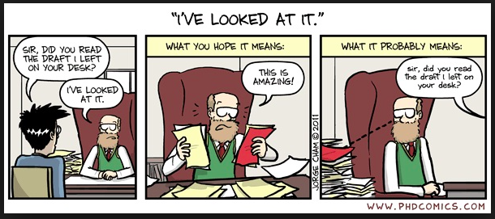

Slide 29
What's the problem ….?

Slide 30
What's the problem ….?
Communication …

Slide 31
Communication …
Communication …

Slide 32
Its all about …
Communication …
Communication …
COMMUNICATION!!!

Slide 33
Pitching Research =>
… to an academic expert …
a difficult task made easier

Slide 34
A Simple tool: A methodical mindset
FOUR | Four Big Picture Anchors
(A) Working Title
(B) Basic Research Question
(C) Key paper(s)
(D) Motivation/Puzzle
THREE | Three essential Building Blocks
(E) Idea?
(F) Data?
(G) Tools?
TWO | Two key questions
(H) What’s New?
(I) So What?
ONE | One bottom line
(J) Contribution?
(K) Other Considerations

Slide 36
You have 1,000 words ± 20% (2 pages)
5 golden rules => make your chosen 1,000 words:
Clear - focused & to the point
Meaningful
Effort-based
Connected
Start a conversation (i.e. communication!)

Slide 37
=> # words/sentences/dot points
FOUR | Four Big Picture Anchors
(A) Working Title | 10-12 words
(B) Basic Research Question | 20-30 words (1-2 sentences)
(C) Key paper(s) | 60-70 words (3 papers)
(D) Motivation/Puzzle | 150-200 words (4-6 sentences or dot points)
THREE | Three essential Building Blocks
(E) Idea? | 100-150 words (3-6 dot points)
(F) Data? | 100-150 words (3-6 dot points)
(G) Tools? | 100-150 words (3-6 dot points)
TWO | Two key questions
(H) What’s New? | 50-100 words (2-4 sentences)
(I) So What? | 50-100 words (2-4 sentences)
ONE | One bottom line
(J) Contribution? | 50-100 words (2-4 sentences)
(K) Other Considerations | 50-100 words (3 dot points)

Slide 38
YouTube Worked Example
2017 UQuAPS Pitching Research Runner-up: Cerys Downing
https://www.youtube.com/watch?v=sWOE2AZDYVI&feature=youtu.be

Slide 39
… but where can I learn more …?!

Slide 40
For a more detailed explanation … essential reading
refer to the SSRN paper =>
Faff, R., (2021), “Pitching Research”, Available at SSRN: http://ssrn.com/abstract=2462059

Slide 41
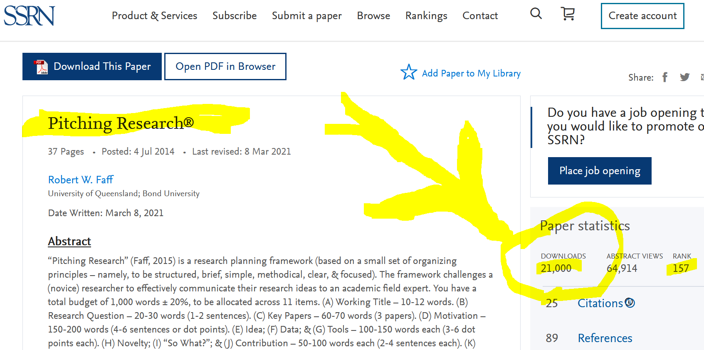

Slide 42
48 minute video Master Class
https://youtu.be/FWA2yxAqwns

Slide 43
9 min “primer” animation
http://bit.ly/2gZD6eG

Slide 44
So, how does this all come together then …?
➔ Pitching Responsible Science …?

Slide 45
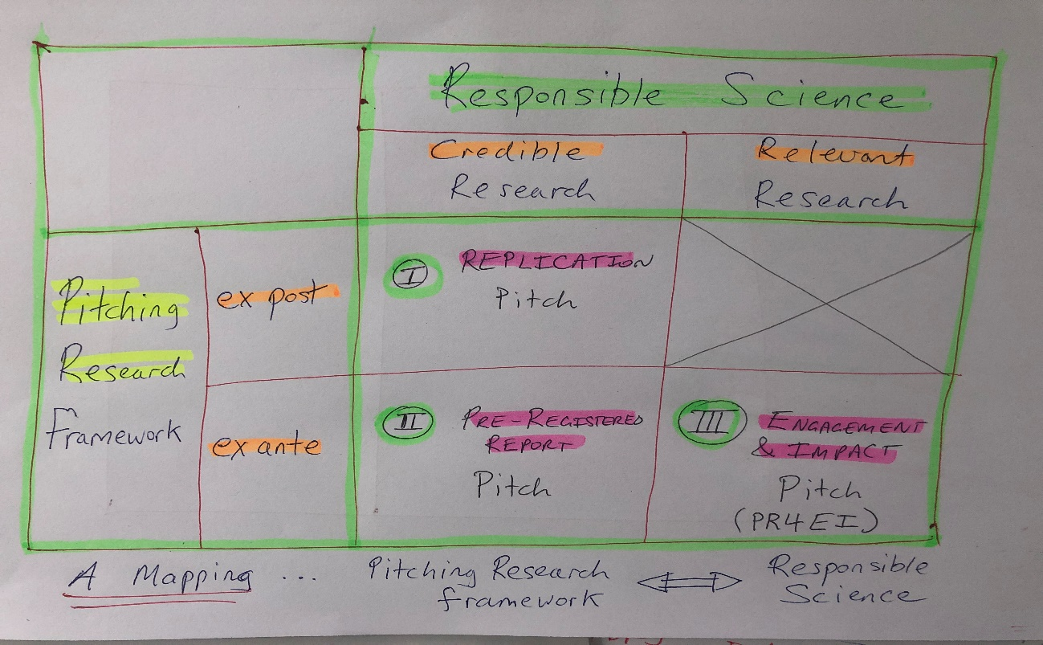

Slide 46
GOAL #3 … helping supervisors with …
Other Pitching Resources & Opportunities

Slide 47
Website: One-stop Shop for all things “pitching”
http://www.pitchingresearch.com/

Slide 48
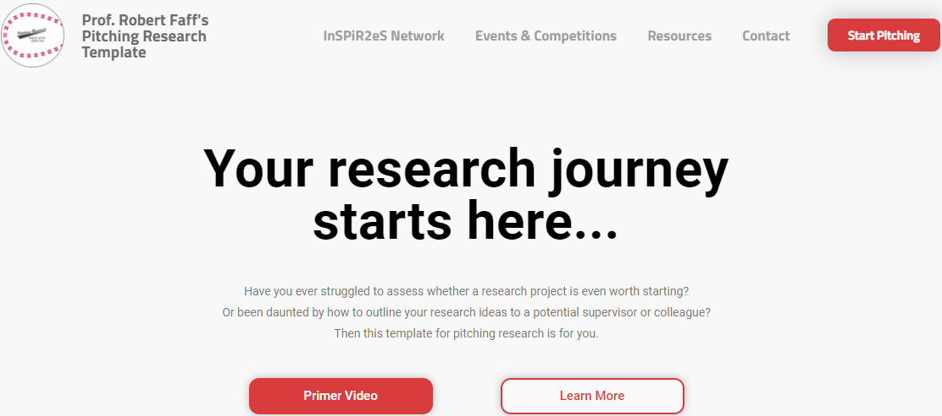

Slide 49
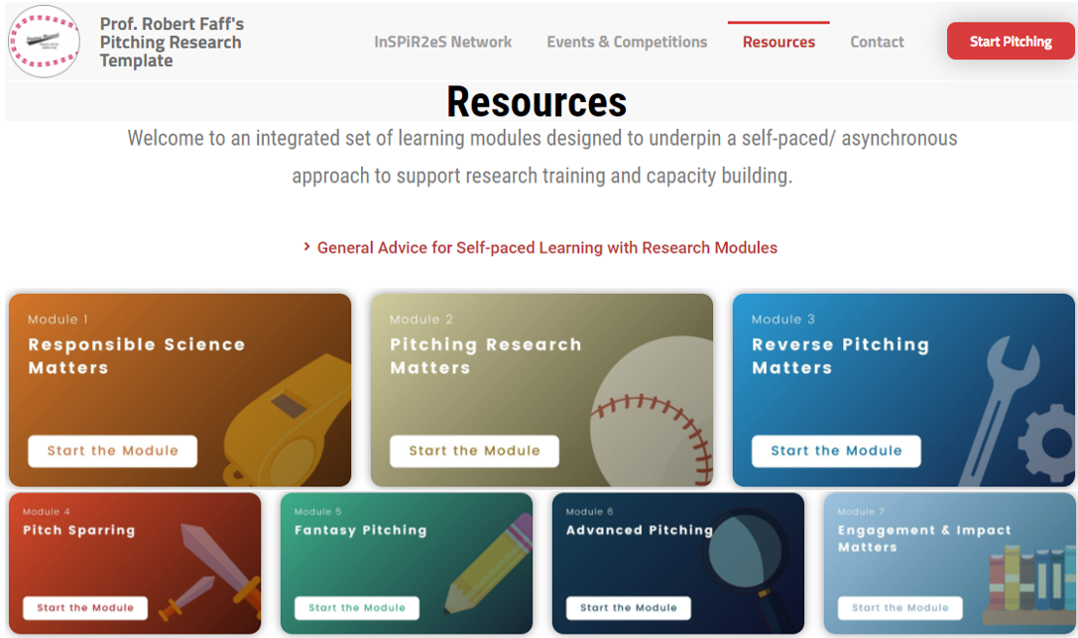

Slide 50
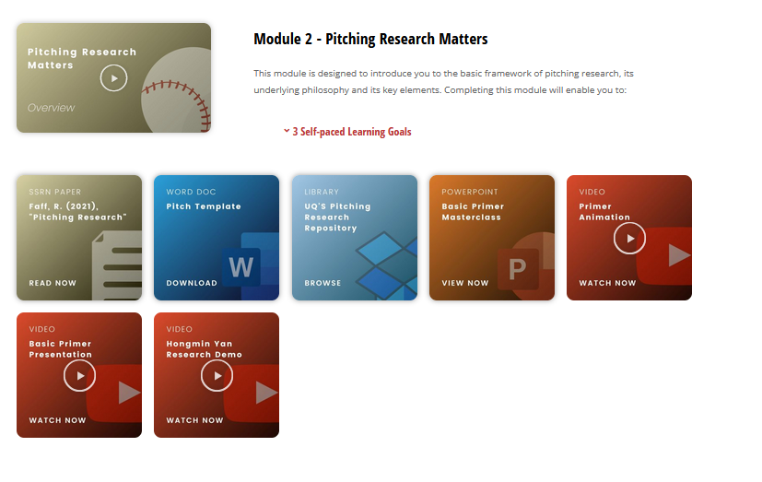

Slide 51
Coming soon …
… free Micro Credential offered by Bond University
… “Pitching Research Matters”
… formal version of Module #2, 10 hours of learning content
… formative assessment & quizzes
… official certificate of completion at the end …

Slide 52
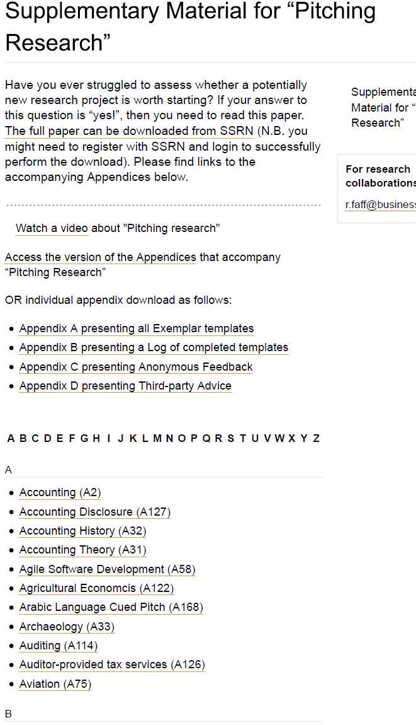
EG: Online Library: https://bit.ly/29LatgM

Slide 53
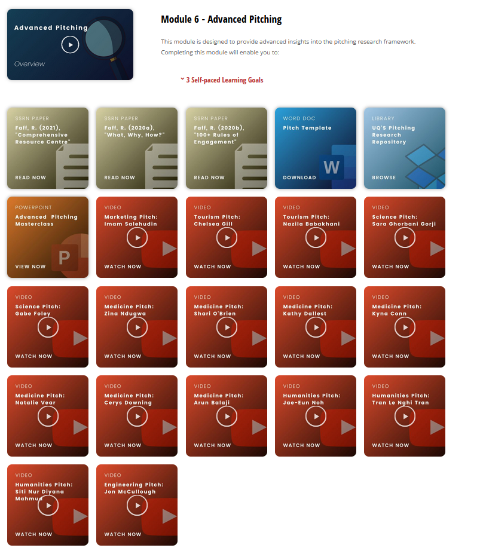

Slide 54
Introducing InSPiR²eS … the International Society of Pitching Research for Responsible Science
https://pitchingresearch.com/inspir2es-network/

Slide 55
thank you!
Professor Robert Faff
Bond University & University of Qld
Signature SSRN paper:
“Pitching Research”: http://ssrn.com/abstract=2462059

